Slide 1
Flight Cost Analysis
By: Connor Crossey, Sharon Darst, Sai Kondrakunta, Kelly McVey, and Julian Yanez

Slide 2
Project Process
1. Decided on project theme
2. Identify data sources
3. Hypothesis
4. Analyzed the information
Parsed
Stats
Graphing/Exploration
5. Review, reorganize
6. Conclusions

Slide 3
Project Description
We will be analyzing flight data from 2008 – 2018 in order to find trends in airfare and the impact on travel volume over time.
Data Sources:
AirFare & Passenger data came from Bureau About the Bureau of Transportation Statistics (BTS).
BTS assures the credibility through rigorous analysis, transparent data quality, and independence from political influence.
The Bureau’s National Transportation Library (NTL) is the permanent, publicly accessible home for research publications from throughout the transportation community; the gateway to all DOT data; and the help line for the Congress, researchers, and the public for information about transportation. https://www.transtats.bts.gov

Slide 4
Passenger Trends Annually & Quarterly
Passengers_overtime.html
Decade_Quarter_Total.png

Slide 5

Airfare Trends Over Time
Airfare_overtime.html

Slide 6
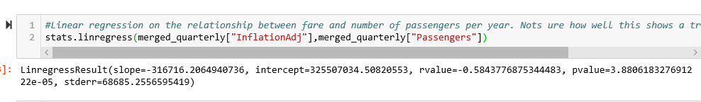
Compare effects of airfare on travel volume (stats)
Airfare_Impact.html

Slide 7
Oil Price Over Time
OilPrice_OverTime.html

Slide 8
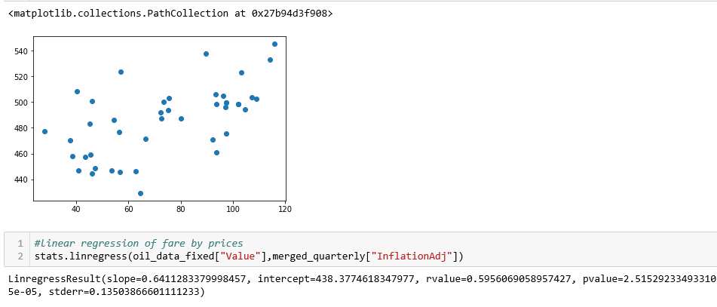
Airfare vs Oil Prices
OilPrice_vsAirFare.html
OilPrice_OverTime.html

Slide 9
Airfare & Passengers Compared
Airfare_overtime.html
Passengers_overtime.html

Slide 10
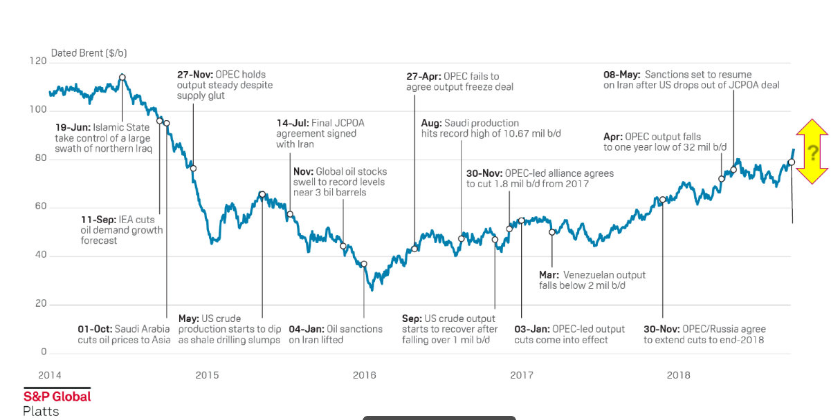
Oil Prices over time

Slide 11
Summary
People are traveling more (not less)
Passengers_overtime.html
AirFare cost has decreased over the last decade
Airfare_overtime.html
More travel occurs by quarter
Decade_Quarter_Total.png
Cost of AirFare by State (interesting to see)
AirFarebyState.html

